Slide 1


Marathwada Mitra mandal’s
COLLEGE OF ENGINEERING
Karvenagar, Pune
An Autonomous Institute
Presentation
On
Travel Planning Application: Design a travel
planning app that helps users research destinations,
plan itineraries, and book accommodations with a focus on ease of use and visual appeal.

Slide 2
Group Information
Sr.No | Prn No | Name of students
1. | B24IT1038 | Pranav Chavan
2. | B24IT1035 | Sarthak Lohar
3. | B24IT1060 | Rushikesh Gadekar
4. | B24IT1028 | Dhiraj Bhosale

Slide 3
Introduction
Hey everyone, and welcome to our presentation on the UI/UX design for my travel app!
The idea behind this project was simple: traveling should be exciting, not stressful. But with so many apps out there that feel clunky or overwhelming, I wanted to create something that actually makes the planning process feel just as smooth and enjoyable as the trip itself.
In this presentation, I’ll walk you through the design choices I made — from the layout and navigation to the overall look and feel — all focused on making the experience intuitive, helpful, and visually engaging for users. Whether someone’s planning a weekend getaway or a big overseas adventure, this app is designed to help them every step of the way.
Let’s get into it!

Slide 4
Objective
Create a user-friendly interface that simplifies the travel planning experience for users of all ages.
Design a visually appealing UI that captures the excitement and spirit of travel.
Ensure smooth and intuitive navigation across the app to enhance overall usability.
Incorporate key travel features such as trip planning, booking, itinerary tracking, and real-time updates.
Focus on responsive design to provide a seamless experience across mobile and tablet devices.
Apply user-centered design principles through research, feedback, and usability testing.
Enhance user engagement by integrating personalized recommendations and smart features.

Slide 5
Feature (Module Description)
Home Dashboard A clean and welcoming interface that offers quick access to all major sections — upcoming trips, popular destinations, and personalized suggestions based on user preferences.
My Documents Allows users to save and manage their documents which make them easy to access.
Explore Destinations A discovery section with curated travel content, trending locations, and filters for budget, climate, travel style, and more. Users can bookmark places they’re interested in.
Booking System Integrated booking for flights, hotels, and experiences — all in one place. Provides price comparisons, travel deals, and user reviews to help with decisions.
Currency and language
A dedicated option for currency exchange stores near the users location and language related options also.
Travel Assistant Offers real-time updates such as weather forecasts, flight status, local alerts, and suggestions during the trip. Also supports offline mode for remote areas.
Profile & Preferences Lets users set travel preferences (e.g., preferred budget, travel style, food preferences) and track past and upcoming trips. Also includes a wishlist feature.

Slide 6
Functional requirement
User Authentication: Secure login and registration for users.
Destination Search: Ability to search for destinations using keywords, categories, and potentially maps.
Accommodation Search & Filtering: Search for hotels, hostels, guesthouses, etc., with budget filters (price range, amenities).
Transportation Search & Filtering: Search for flights, trains, buses, etc., with budget filters (price, travel time).
Activities/Experiences Search & Filtering: Search for tours, free activities, local experiences with budget filters.
Price Comparison: Displaying prices from multiple sources for accommodation, transport, and activities.
Booking Management: Ability to book and manage reservations.
Itinerary Creation & Management: Tools for users to create, save, and organize their trip itineraries.
Itinerary Sharing: Functionality to share itineraries with friends via links or social media.
User Reviews & Ratings: System for users to submit and view reviews and ratings for accommodations, activities, etc.
Deals & Promotions Display: A section to showcase available discounts and special offers.
User Profiles: Ability for users to save preferences and booking history.
Notifications: Alerts for price drops, booking confirmations, and other relevant information.
Currency Conversion: Displaying prices in different currencies.

Slide 7
Non-functional requirements
Performance: The app should load quickly and respond to user interactions efficiently.
Scalability: The app should be able to handle a growing number of users and data.
Security: User data and payment information should be protected with appropriate security measures.
Usability: The app should be intuitive, easy to navigate, and user-friendly for the target audience.
Reliability: The app should be stable and function without frequent errors or crashes.
Availability: The app should be accessible to users most of the time.
Maintainability: The codebase should be well-structured and easy to maintain and update.
Accessibility: The app should be accessible to users with disabilities (following WCAG guidelines).
Responsiveness: The app should adapt seamlessly to different screen sizes and orientations on various mobile devices.
Battery Efficiency: The app should minimize battery consumption.
Data Usage Efficiency: The app should minimize data usage, especially for users with limited data plans.
Localization: Support for multiple languages and currencies.

Slide 8
Task Flows
Search Destination
Select Dates & Travellers
Choose a Package/Service
Open App
Confirm Booking
Enter Payment Details

Slide 9
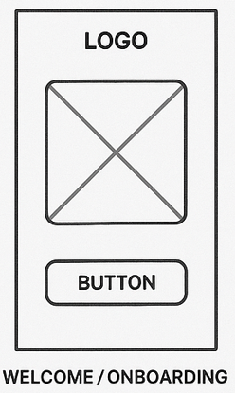
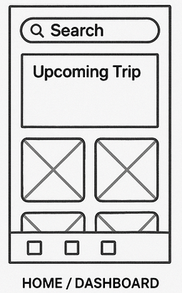
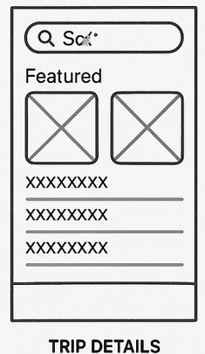
Low-Fidelity Wireframes

Slide 10
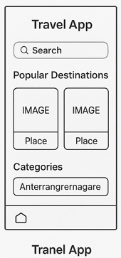
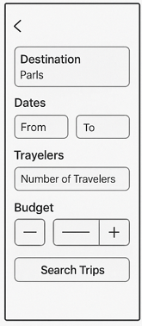
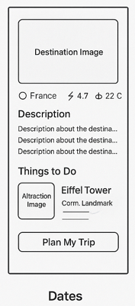
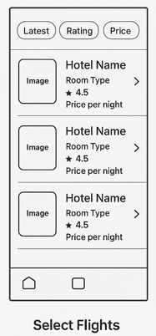
Low-Fidelity Wireframes

Slide 11
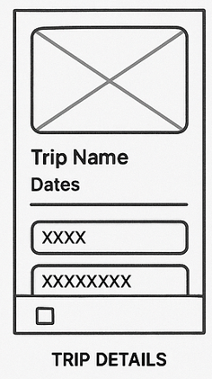
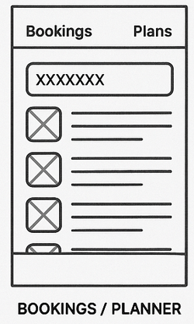
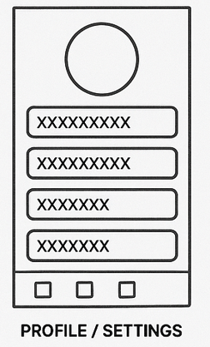
Low-Fidelity Wireframes

Slide 12
Link of Prototype
Link to the Interactive Prototype
https://www.figma.com/design/qnteolnXaaklxnBX99eiup/EEl-Mini-Project?node-id=0-1&t=3ufMhVmLWw6o6Gnx-1
Link to the Github Repository
https://github.com/Pranavjcm/Project_Sem2_UI-UX

